Slide 1

Online Examination System (Quiz)

Slide 2

Group IV
Submitted To
Sadah Anjum Shanto
Lecturer
Department of CSE
Bangladesh University of Business and Technology
Submitted By
MD. Ahsan Habib
ID:17182103289
Department of CSE
Bangladesh University of Business and Technology
Tahmid Ahmed
ID:17182103311
Department of CSE
Bangladesh University of Business and Technology

Slide 3


INTRODUCTION
Online examinations contents providers to focus on creating effective assessment questions and focusing on exam’s feedback delivery to students. In the paper we present techniques that are pertinent to the elements of assessment process: answers submission, computerized grading, and feedback after submission.

Slide 4

Motivation & Goal
The ongoing COVID-19 pandemic has forced educational institutions to re-think in-person learning and move to the online learning sphere. Pen-and-paper examinations are still the standard, and preferred, way of communication among many ‘traditional’ educational institutions. However, with global conditions as they are, they have been forced to look at online examinations as a solution.

Slide 5
Tools
Design Language
HTML, CSS, JavaScript
Bootstrap
Coding Language
PHP, MySQL
Software
Brackets, Xammp Server,
Google Chrome

Slide 6






Student
Registration Login Take Exam See Rank
Exam Result Logout

Slide 7







Admin
Admin Login Student List Question List Question Input
Subject Enter Modify Details See Feedback Logout

Slide 8
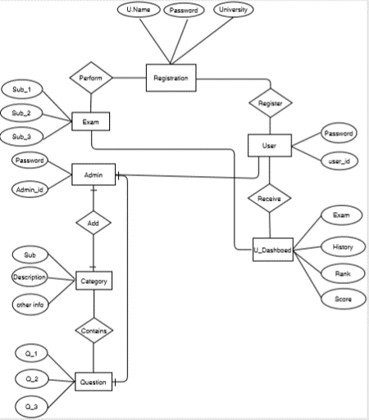
ER Diagram

Slide 9
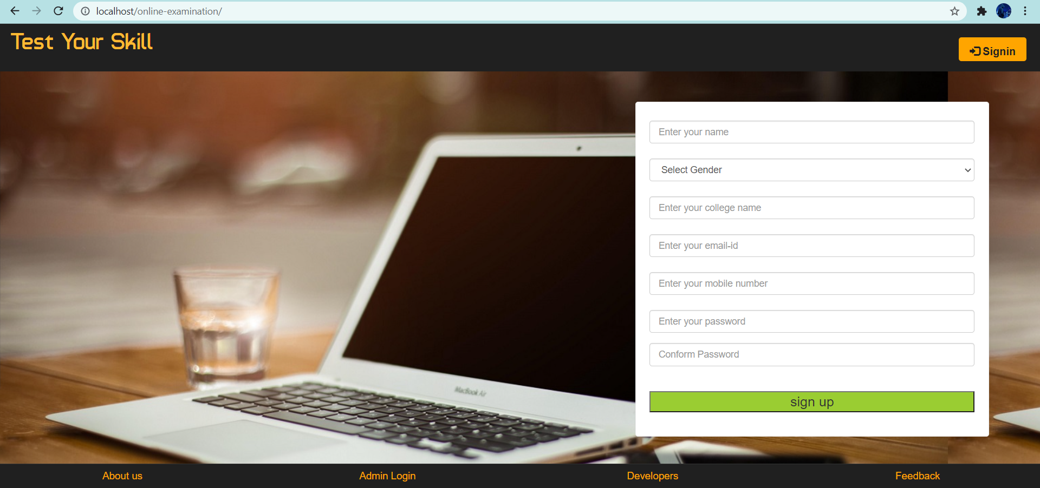
Homepage

Slide 10
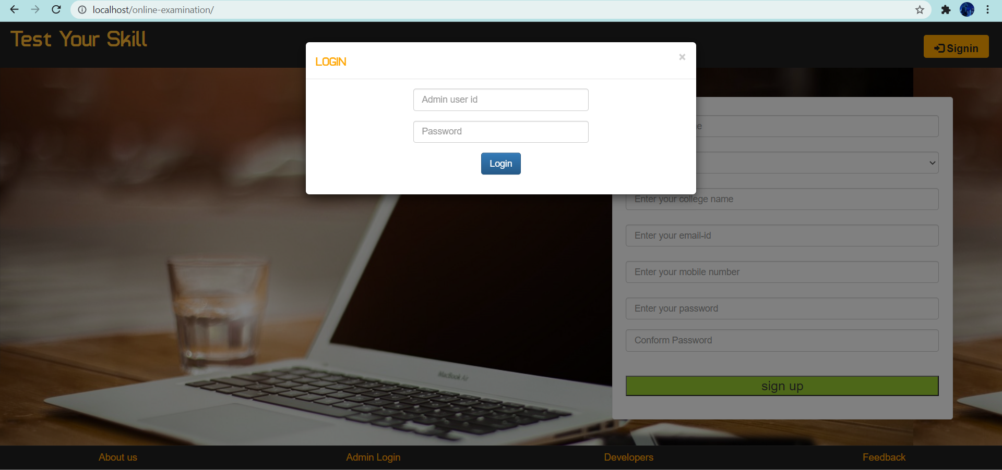
Admin Login

Slide 11
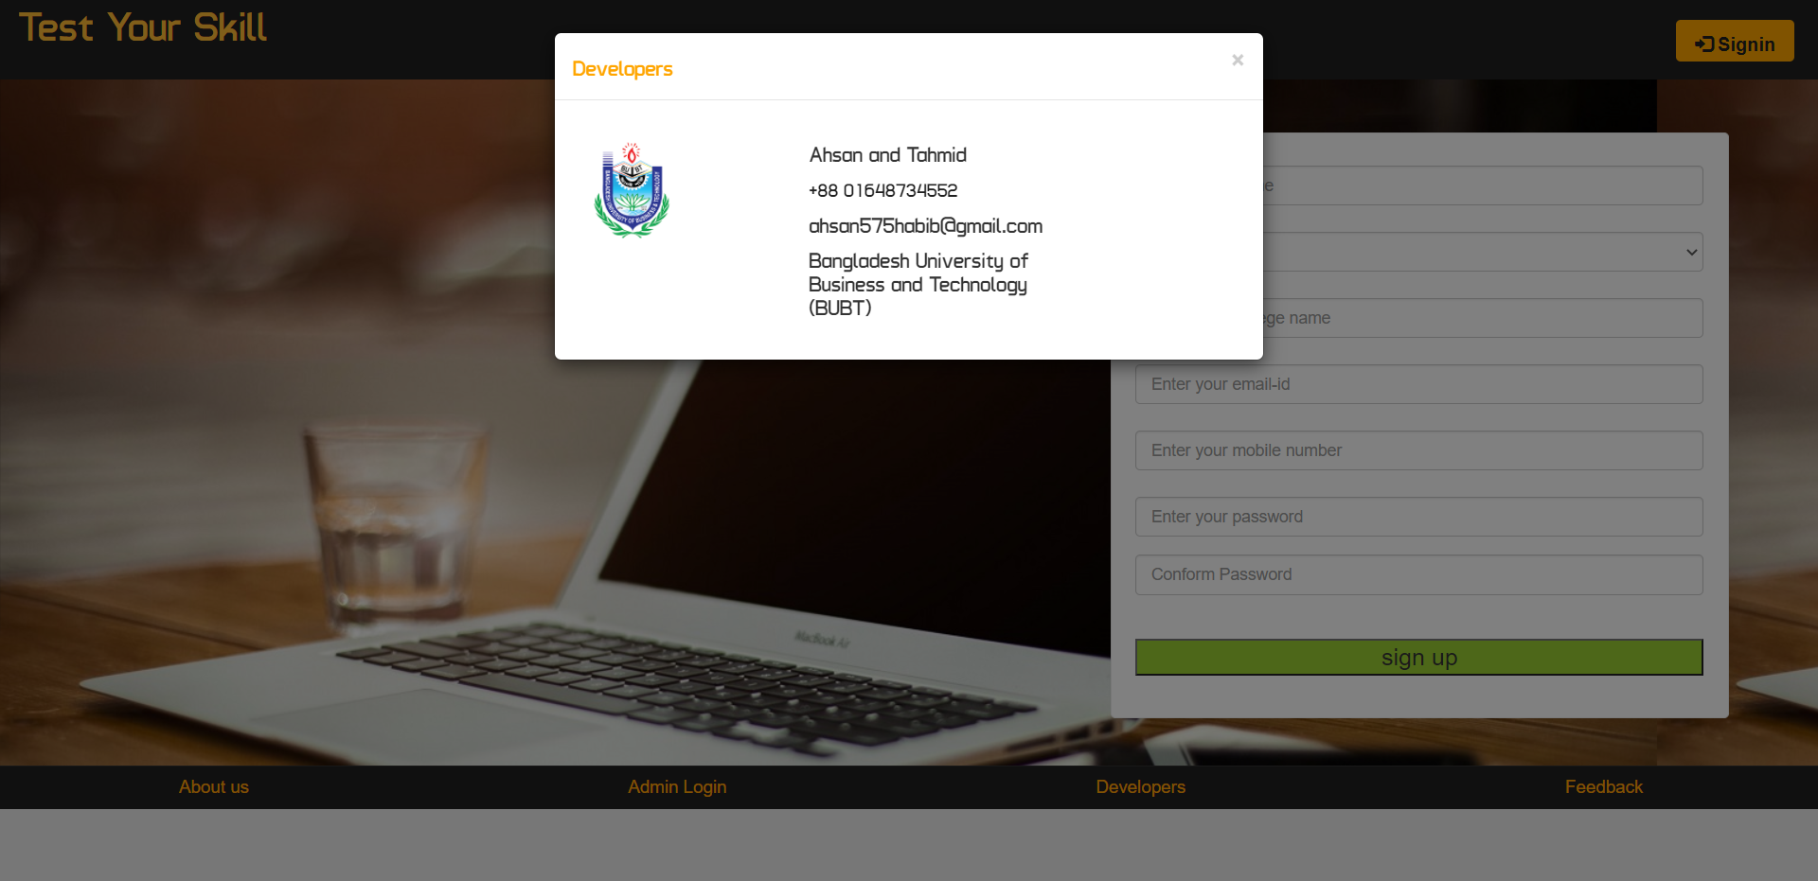
Developers

Slide 12
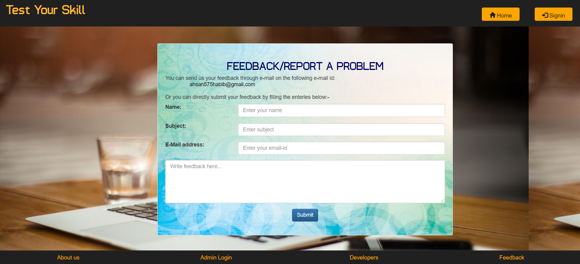
Feedback

Slide 13
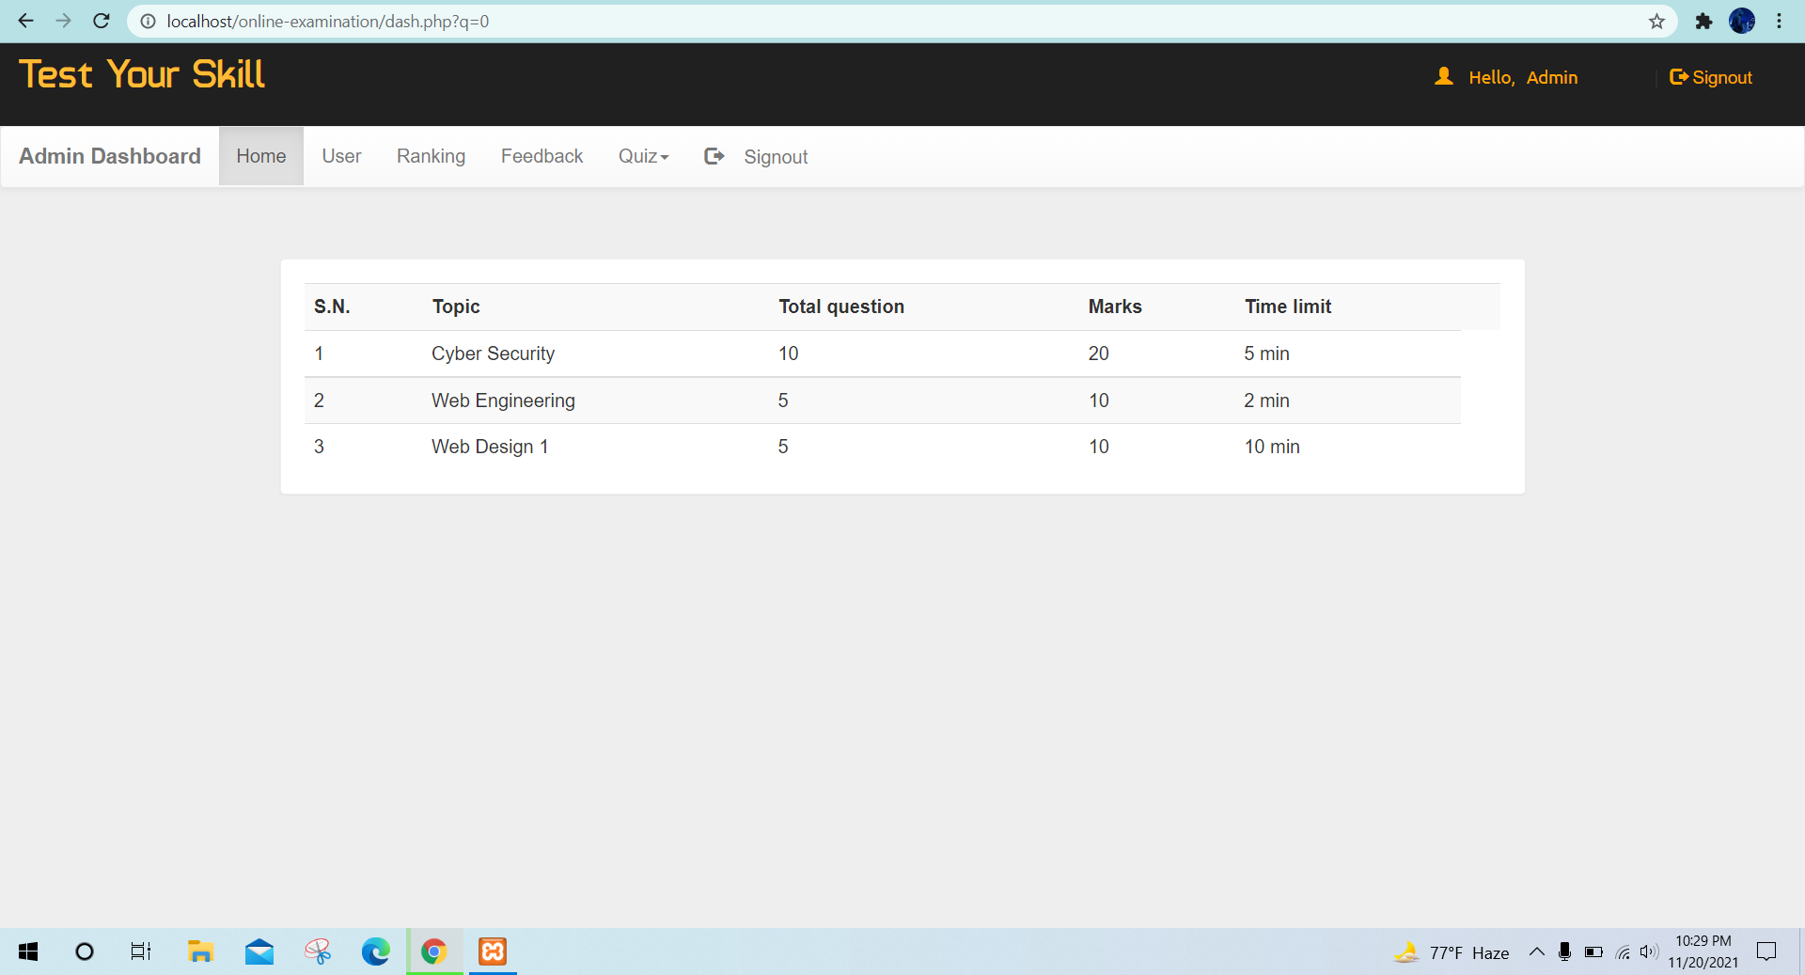
Admin Dashboard

Slide 14
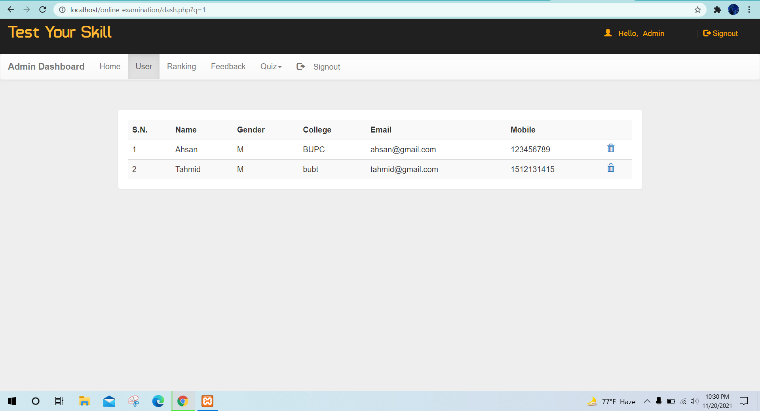
Admin
User

Slide 15
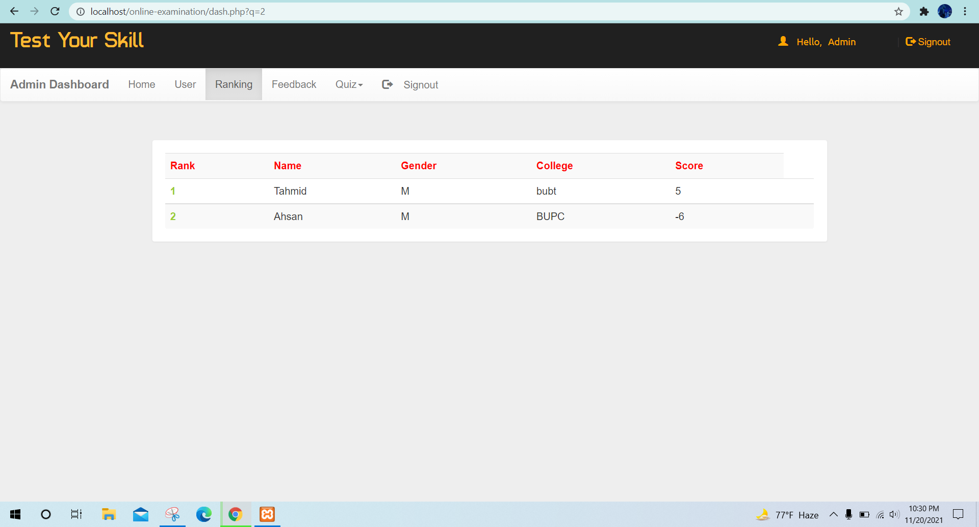
Admin
Ranking

Slide 16
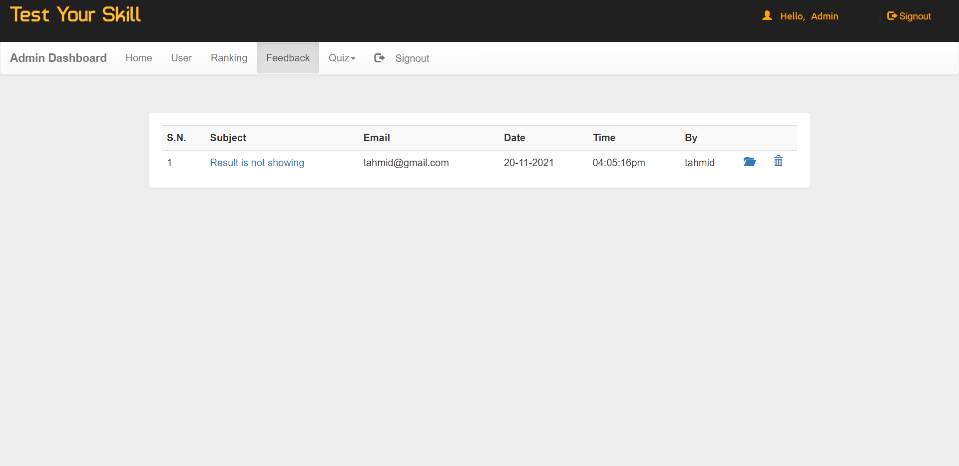
Admin
Feedback

Slide 17
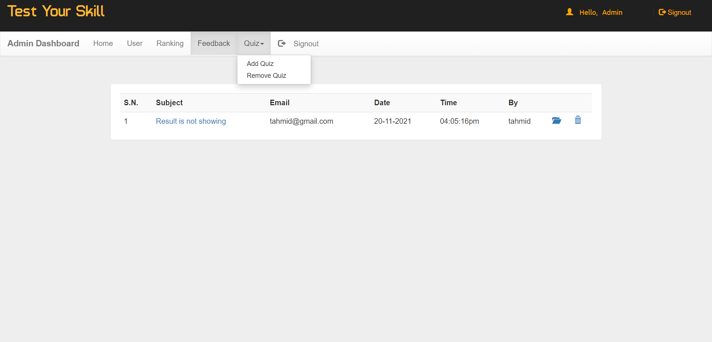
Admin
Quiz

Slide 18
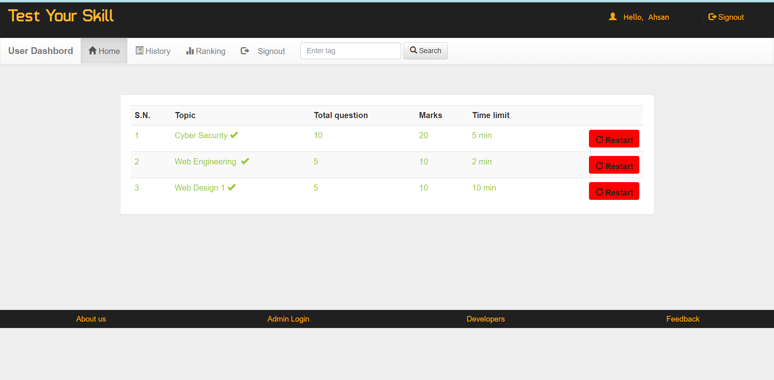
User
Dashboard

Slide 19
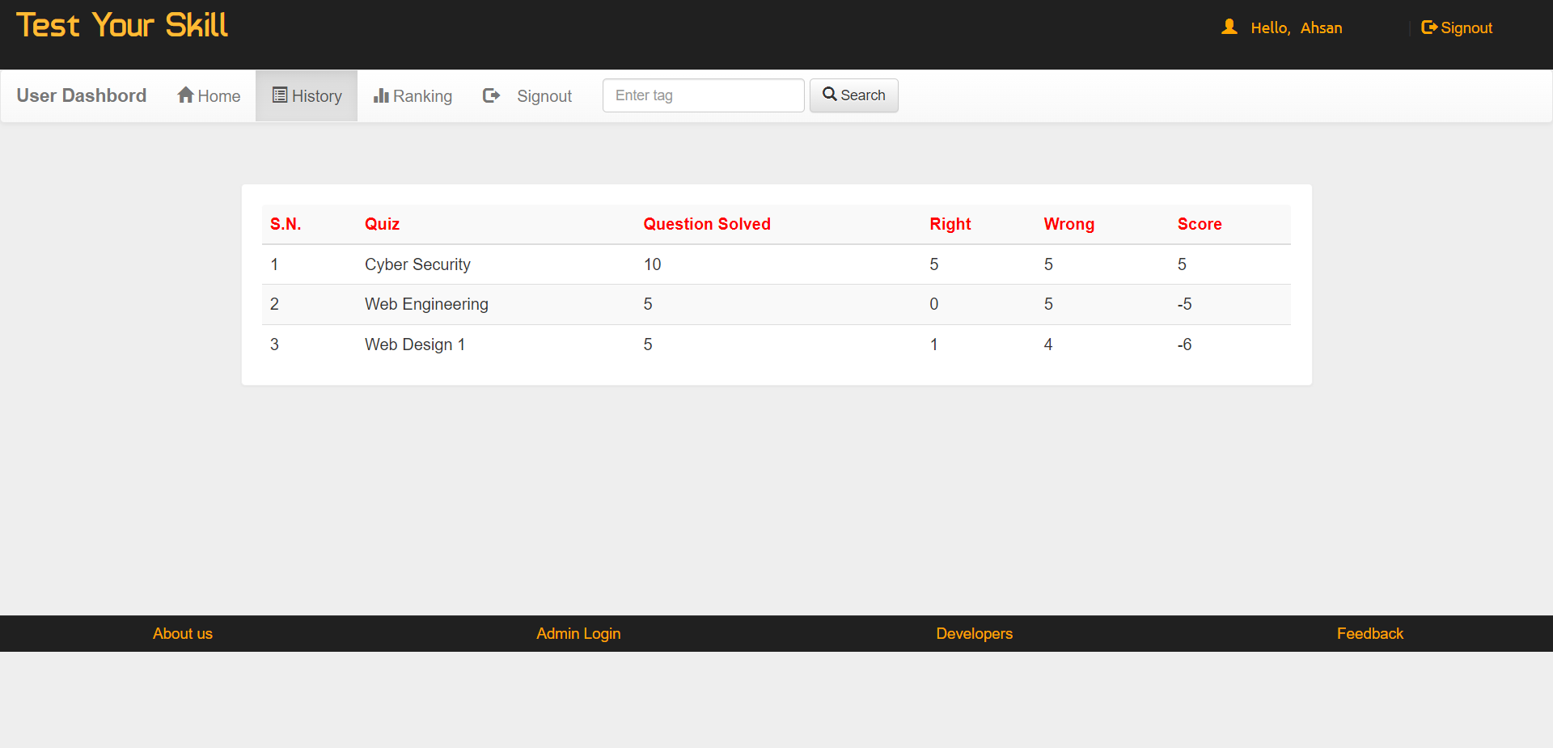
User
History

Slide 20
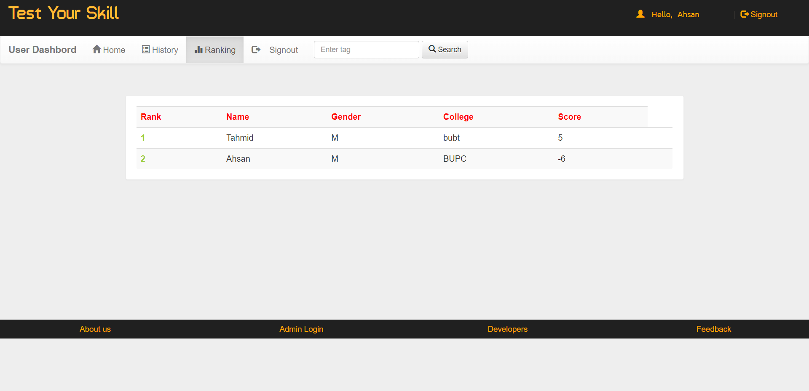
User
Ranking

Slide 21
Limitations & Future Aspects
Searching : We didn’t implement the search option yet.
Email: Email notification is not available.
Responsive: Our website is not responsive.

Slide 22


